Slide 1
Operational functions of HUMAN RESOURCE MANAGEMENT

Slide 2
Procurement Function
Procurement is first operational function of Human resource. Procurement is subjected to procuring and employing people who fits the position and have necessary skill set, mindset, attitude and knowledge.
Job analysis
Manpower planning
Recruitment
Selection
Placement

Slide 3
Recruitment and selection
In short, Recruitment and Selection is the process of sourcing, screening, short listing and selecting the right candidates for the filling the required vacant positions.
The scope of Recruitment and Selection includes the following operations:
Dealing with the excess or shortage of resources
Preparing the Recruitment policy for different categories of employees
Analyzing the recruitment policies, processes, and procedures of the organization
Identifying the areas, where there could be a scope of improvement
Streamlining the hiring process with suitable recommendations
Choosing the best suitable process of recruitment for effective hiring of resources

Slide 4
Job Analysis
Job analysis is a process of identifying, analyzing, and determining the duties, responsibilities, skills, abilities, and work environment of a specific job. These factors help in identifying what a job demands and what an employee must possess in performing a job.
The following steps are important in analyzing a job:
Recording and collecting job information
Accuracy in checking the job information
Generating job description based on the information
Determining the knowledge and skills, which are required for the job

Slide 5
Job description:
Job description is an important document, which is descriptive in nature and contains the final statement of the job analysis. This description is very important for a successful recruitment process. Job description provides information about the scope of job roles, responsibilities and the positioning of the job in the organization. And this data gives the employer and the organization a clear idea of what an employee must do to meet the requirement of his job responsibilities.

Slide 6
Job Description
A job description provides information on the following elements:
Job Title / Organization Position
Job Location
Summary of Job
Job Duties
Machines, Materials and Equipment
Process of Supervision
Working Conditions

Slide 7
Training and development
Training and development is the field which is concerned with organizational activity aimed at bettering the performance of Individuals and groups in organizational setting. It is a combined role often called human resources development (HRD) meaning the development of “Human” resources to remain competitive in the marketplace. Training focuses on doing activities today to develop employees for their current jobs and development is preparing employees for future roles and responsibilities.
In order to ensure that our employees are equipped with the right kind of skills, knowledge and abilities to perform their assigned tasks, training and development plays its crucial role towards the growth and success of our business.

Slide 8
Training and development
Training and development are very vital in any company or organization that aims at progressing. This includes decision making, thinking creatively and managing people. Training and development is so important because:
Help in addressing employee weaknesses
Improvement in worker performance
Consistency in duty performance
Ensuring worker satisfaction
Increased productivity
Improved quality of service and products

Slide 9
Compensation:
Compensation is the remuneration received by an employee in returns of their contribution to the organization. The compensation management is an organized practice which is important for balancing the work and employee relationship by providing monetary and non-monetary compensation to employees.
Base pay (hourly or salary wages)
Sales commission.
Overtime wages.
Tip income.
Bonus pay.
Recognition or merit pay.
Benefits (insurances, standard vacation policy, retirement)

Slide 10
Performance appraisal
After placed and trained as an employee on the job, the next important and essential step in the management of human resources of an organisation is to evaluate the performance of an employee on the job. The management must be able to recognize the level of an employee’s job performance and then they can be rewarded on the basis of their contributions to organizational goals. It is the process of deciding how employees do their jobs and if any problems are identified, then immediately steps are taken to remedy them.

Slide 11
Productivity Factors

Slide 12
What Is Productivity?
Productivity, in economics, measures output per unit of input, such as labor, capital or any other resource – and is typically calculated for the economy as a whole, as a ratio of gross domestic product (GDP) to hours worked.
The classic productivity definition is “a way to measure efficiency.” In an economic context, productivity is how to measure the output that comes from units of input. Farming makes for a good example: One acre of land that produces 10 pumpkins? That’s not very productive. But one acre of land that produces 2,000 pumpkins? That’s a much better return on your pumpkin planting

Slide 13
GROSS DOMESTIC PRODUCT
GDP measures the monetary value of final goods and services
It counts all of the output generated within the borders of a country. GDP is composed of goods and services produced for sale in the market.
for example, that a baker who produces a loaf of bread for a customer would contribute to GDP, but would not contribute to GDP if he baked the same loaf for his family (although the ingredients he purchased would be counted).

Slide 14
Productivity is commonly defined as a ratio between the output volume and the volume of inputs. As shown below:
Productivity = output/inputs
Efficiency = output/inputs * 100
The classic productivity definition is : “a way to measure efficiency.”

Slide 15
In an economic context, productivity is how to measure the output that comes from units of inputs.

Slide 16
The various decisions with respect to the factors are mentioned below:
1. Man Power:
Selection of right man for a specific job Applying well known saying division of labour.
Training i.e. consideration of training requirements whether to be imparted training in the plant itself or to be sent for training outside the unit to other plants within the country or abroad or training institutes.
Number of personnel required i.e. man power requirement planning in each of the departments of required skill.

Slide 17
2. Equipment and Machines:
The number of machine tools, their capacity and accessories required, replacement policy of the organization and maintenance schedules etc.
3. Input Materials:
i. Appropriate quality of materials
ii. Material requirement planning (M.R.P.)
iii. Substitute of materials being used
iv. Inspection of input materials at various points
v. Cost of materials procurement and handling up to stores.

Slide 18
4. Time:
Time is significant for the following reasons:
i. Inspection of input materials i.e. raw material and semi finished or finished items required for assembly.
ii. Time for inspection of finished products.
ADVERTISEMENTS:
iii. Production time (total time of manufacturing).
iv. Time for repair and maintenance of machines and equipment.

Slide 19
7. Finance:
Finance is required to maintain all the above requirements. The management should be for minimum rather optimum finance.
8. Movement of Man and Materials:
i. The required motion of manpower within the plant
ii. The motion of raw material semi finished and finished products/items within the plant.

Slide 20
9. Work Environment
An employee’s work environment influences their mood, drive and overall performance in your organization. The idea is simple – give your employees a supportive work environment, and they’ll be productive.

Slide 21
10. Processes
Processes, or their absence, has a huge impact on organizational productivity.
Implementing processes is one of the most effective ways to boost team productivity. A process defines a specific sequence of steps for executing a particular task.
11. Goals
Clearly defined work goals are great for boosting productivity levels because they’re measures of productivity themselves.

Slide 22
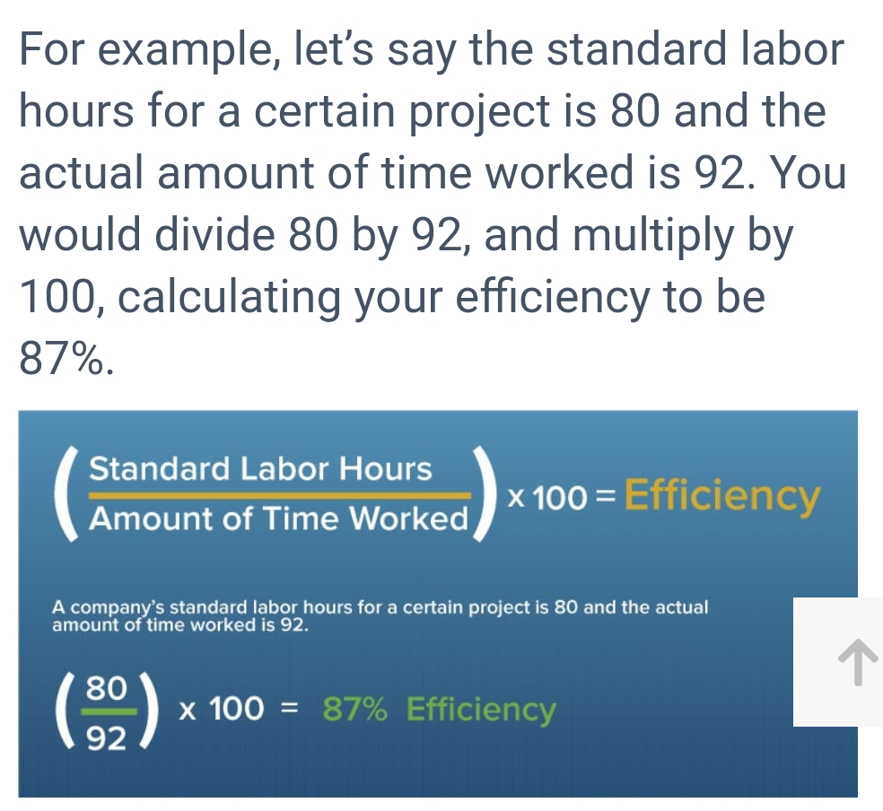

Slide 23
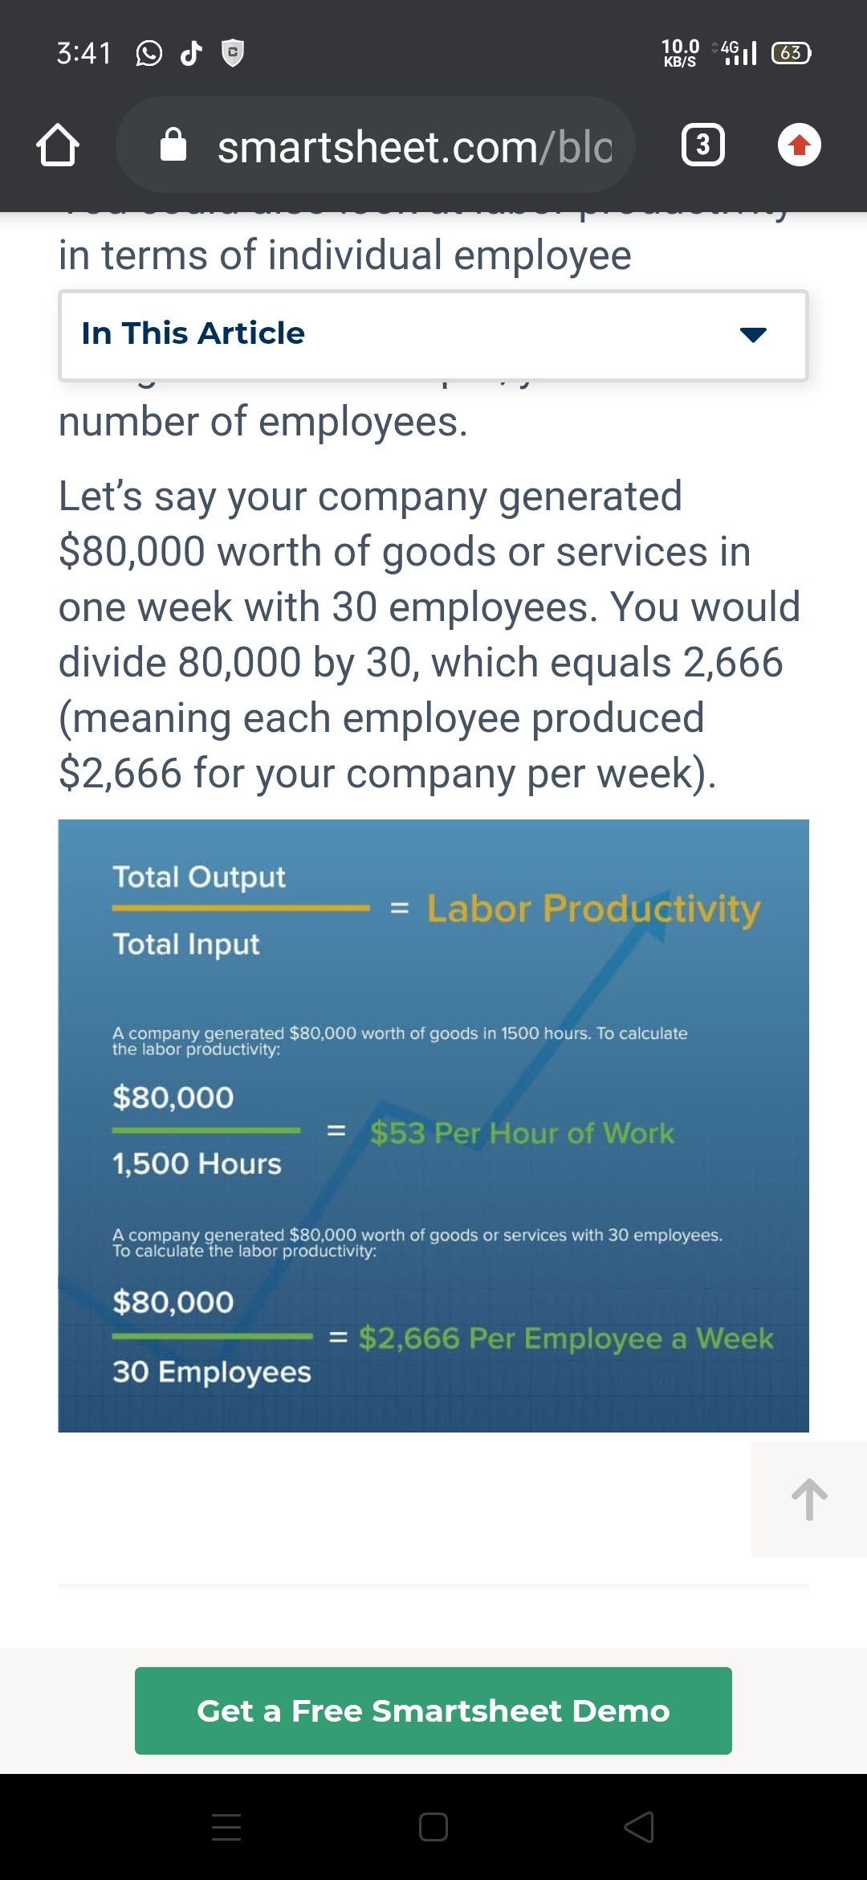

Slide 24
Other factors
The factors that affect productivity are:
TECHNICAL FACTORS: - Technical factors are the most important factor. Productivity largely depend on technology, these include proper location, layout and size of the plant and machinery, correct design of machine and equipment etc.
Production factors: Productivity is related to the production-factors. The production of all departments should be properly planned, coordinated and controlled. The right quality of raw-materials should be used for production.
Organizational factor: Productivity is directly proportional to the organizational factors. A simple type of organization should be used. Authority and Responsibility of every individual and department should be defined properly. The line and staff relationships should also be clearly defined. So, conflicts between line and staff should be avoided. There should be a division of labor and specialization as far as possible. This will increase organization's productiveness.

Slide 25
Government factors: Productivity depends on government factors. The management should have a proper knowledge about the government rules and regulations. They should also maintain good relations with the government.
Finance factors: Productivity relies on the finance factors. Finance is the life-blood of modem business. There should be a better control over both fixed capital and working capital. There should be proper Financial Planning. Capital expenditure should be properly controlled.

Slide 26
Conclusion
Employee productivity is a key determinant in your company’s success. No company will get very far without a solid, productive workforce behind it. That’s why it makes sense to spend time and money investing in your employee’s productivity.

